Slide 1
Understanding the Length of Consent Forms for Cancer Clinical Trials
Quyen Duong, PhD
Mayo Clinic

Slide 2
Introduction
Informed consent forms are educational tools for patients to understand their role in a clinical trial and to understand the risks
Increased 10-fold in length over time
Detracting from the true educational value of these documents
Microsoft Corporation study
attention spans have shrunk over the past 15 years
Hlubocky (2018) study
fewer than 45% understood the purpose of the trial
only 30% in older patients expressed accurate understanding of the trial

Slide 3
Objective
Examine word counts in solid tumor cancer clinical trial consent forms by funding source

Slide 4
Methods
315 consent forms
cancer clinical trials on solid tumors
Mayo Clinic investigator participated
2004-2010
Phase I, II and III
Funding source
1) Pharmaceutical company-funded
2) National Clinical Trials Network (NCTN)
3) R01- or other non-government-funded grants
4) Mixed category
Word count

Slide 5
Analysis
Chi-square or Fisher’s exact tests
test the association between trial characteristics of consent forms and funding source
Kruskal-Wallis test
evaluate whether there were differences in the median word count by funding source, phase of the trial, and the year the trial opened
Dwass-Steel-Critchlow-Fligner method
test all pairwise comparisons, if the overall test of median differences was significant
Jonckheere-Terpstra test
test for an increasing trend in median word count by the year the trial opened
Notes:
https://link.springer.com/article/10.1007/s13187-020-01757-7#ref-CR9

Slide 6
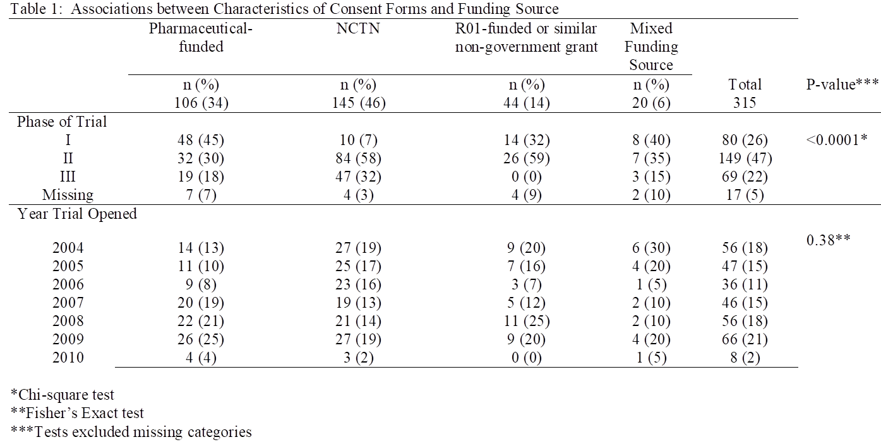
Results

Slide 7
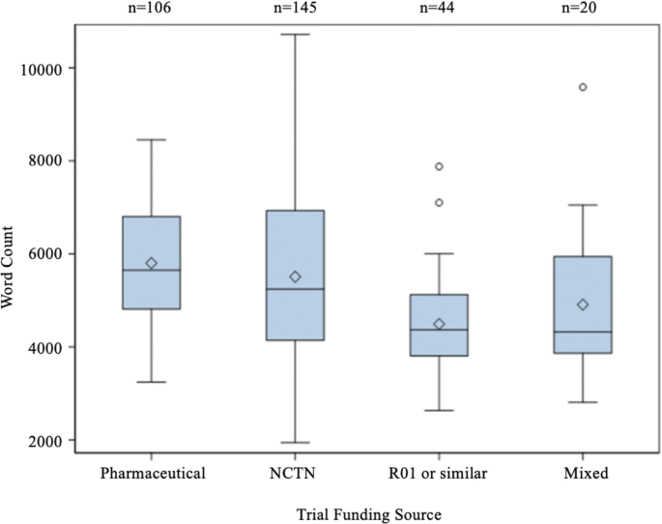
Word Count by Funding Source
p < 0.0001

Slide 8
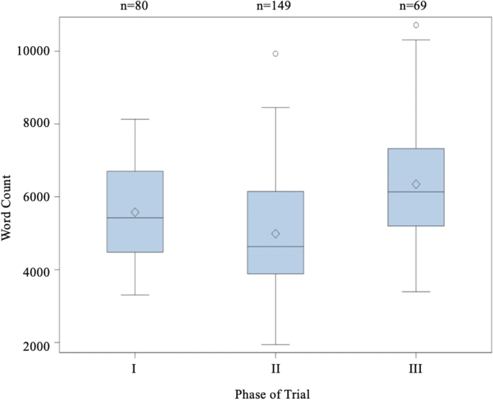
Word Count by Phase of Trial
p < 0.0001

Slide 9
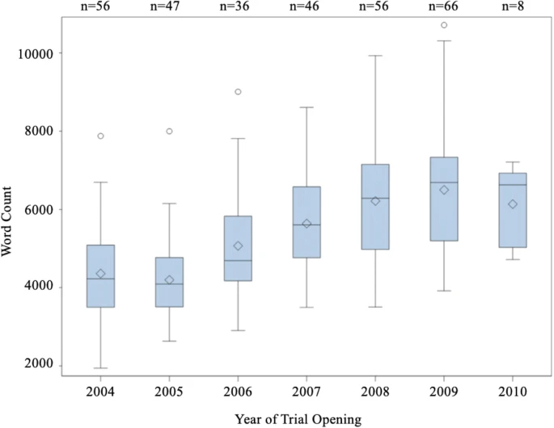
Word Count by Year of Trial Opening
p < 0.0001

Slide 10
Discussion
Pharmaceutical-sponsored trials had wordier consent forms
Phase of trial and date of trial opening were associated with word counts
Largest and most temporally robust study, including 300+ consent forms and spanning 7 years of trials
Testing of new cancer drugs is currently at an all-time high, our finding of increasing verbosity over time is noteworthy

Slide 11
Limitation
Single-institution study
Absence of some data elements
Patient perspective were not included

Slide 12
Acknowledgement
Aminah Jatoi, MD
Jennifer G. Le-Rademacher, PhD
Sumithra J. Mandrekar, PhD
Stacey J. Winham, PhD
Kathryn Cook
This work was supported in part by K12CA090628 and by P30CA15083

Slide 13
Thank You !

